Slide 1


Module 4 : Lecture 3
JAVA BASICS
by Andrei Kliashchonak
January 15, 2016

Slide 2
Module 4 : JAVA Basics : Agenda
1
2
3
Lecture 1
Lecture 2
Lecture 3
Overview
Type of data
Operators and operations
Classes / structures
Base API
OOP
Java Collection Framework
Input/Output streams and Files
Exceptions
Enums

Slide 3
ENUMS

Slide 4
ENUMS: Enum Types
ENUM
An enum type is a special data type that enables for a variable to be a set of predefined constants.
The variable must be equal to one of the values that have been predefined for it.
Because they are constants, the names of an enum type's fields are in uppercase letters.
In the Java programming language, you define an enum type by using the enum keyword.
You should use enum types any time you need to represent a fixed set of constants.
That includes natural enum types (days of a week, compass directions, planets in the solar system, etc.) and data sets where you know all possible values at compile time (the choices on a menu, command line flags, set of data, etc.)

Slide 5
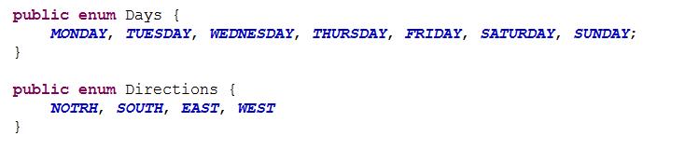

ENUMS: Enum Types: Simple Samples
Natural ENUM types samples:
“User-predefined” ENUM types samples:

Slide 6
ENUM : access enum / default methods
Creation link to point on ENUM value
Browser current1 = Browser.CHROME; // create link to point on CHROME
method String name()
This method returns the name of this enum constant, exactly as declared in its enum declaration.
current1.name(); // returns name string “CHROME”
Browser.CHROME.name(); // direct access
method int ordinal()
This method returns the ordinal of this enumeration constant (its position in its enum declaration, where the initial constant is assigned an ordinal of zero)
current1.ordinal(); // its position in the enum declaration, start from 0
Browser.CHROME.ordinal(); // direct access
method Enum<T> valueOf()
This method returns the enum constant of the specified enum type with the specified name.
Browser current2 = Browser.valueOf("FIREFOX");// returns Browser.FIREFOX
Static-method Enum<T>[] values()
Browser[] browsers = Browser.values(); // gets all possible values of an enum as array

Slide 7
ENUM : Usage example
public void openBrowser(Browser current) { switch (current) { case FIREFOX: // do some staff for firefox break; case CHROME: // do some staff for chrome break; } }
public void printSupportedBrowsers() { for(Browser browser : Browser.values()) { System.out.println(browser.name()); } }

Slide 8
ENUM : Simple, State, Behavior
enum Browser { FIREFOX, CHROME, SAFARI, IE }
// enum with state and behavior public enum Browser { FIREFOX("firefox", "25.0.1"), CHROME("chrome", "46.0.2490.80"); private String alias; private String version; Browser(String alias, String version) { this.alias = alias; this.version = version; } public String getInfo() { return alias + " " + version; } }
// enum with state public enum Browser { FIREFOX("firefox"), CHROME("chrome"); private String alias; Browsers(String alias) { this.alias = alias; } }

Slide 9
EXCEPTIONS

Slide 10
EXCEPTIONS : Call Stack
public class CallStackDemo { public void first() { second(); } private void second() { System.out.println("Job is done!"); } public static void main(String[] args) { new CallStackDemo().first(); } }
…
Start
End
println
println
second
second
second
second
first
first
first
first
first
first
main
main
main
main
main
main
main
main

Slide 11
EXCEPTIONS : Concept
Exceptions
The term exception is shorthand for the phrase “exceptional event”
An exception is an event, which occurs during the execution of a program, that disrupts the normal flow of the program's instructions.
After a method throws an exception, the runtime system attempts to find something to handle it. The set of possible "somethings" to handle the exception is the ordered list of methods that had been called to get to the method where the error occurred. The list of methods is known as the call stack.

Slide 12
EXCEPTIONS : When Happens
Root Cause | Exception Object
x / y (x = 1, y = 0) | java.lang.ArithmeticException
array[i] ( i >= array.length) | java.lang.ArrayIndexOutOfBoundsException
Bad memory utilization | java.lang.OutOfMemoryError
Bad recursion | java.lang.StackOverflowError
I/O fails | java.io.IOException
Link refers to null | java.lang.NullPointerException (NPE)
By keyword throw | Any Your favorite

Slide 13
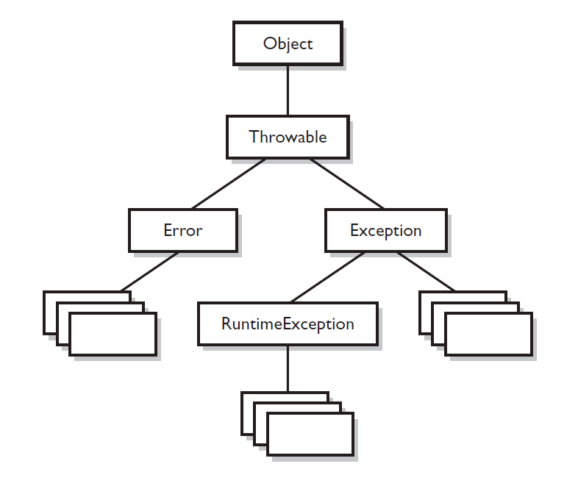
EXCEPTIONS : Common Hierarchy

Slide 14
EXCEPTIONS: Methods
METHOD | DESCRIPTION
public String getMessage() | Returns a detailed message about the exception that has occurred. This message is initialized in the Throwable constructor.
public Throwable getCause() | Returns the cause of the exception as represented by a Throwable object.
public String toString() | Returns the name of the class concatenated with the result of getMessage()
public void printStackTrace() | Prints the result of toString() along with the stack trace to System.err, the error output stream.
public StackTraceElement [] getStackTrace() | Returns an array containing each element on the stack trace. The element at index 0 represents the top of the call stack, and the last element in the array represents the method at the bottom of the call stack.
public Throwable fillInStackTrace() | Fills the stack trace of this Throwable object with the current stack trace, adding to any previous information in the stack trace.

Slide 15
EXCEPTIONS : Checked and Unchecked exceptions
Checked
Unchecked
Exceptions which inherit classes RuntimeException and Error
Exceptions which inherit class Exception BUT are not subclasses of RuntimeException

Slide 16
EXCEPTIONS : checked
A method may be declared as throwing an exception (or several exceptions) in its signature.
If a method throws checked exception, other methods which invoke it should catch such type of exception(s) (using try-catch) or should declare the exception class on its own signature.
public void anyMethodName() throws IOException, RemoteException { …

Slide 17
EXCEPTIONS : How To Catch
try {
// “unsafe” code
} catch (<exception type 1> е) {
// handles exception 1
} catch (<exception type 2> е) {
// handles exception 2
}
…
} finally {
// always executed
}
public static void main(String[] args) { try { // do work throw new Exception("Test 1"); } catch (Exception e) { System.out.println("catch '" + e + "'"); throw new RuntimeException("Test 2"); } finally { System.out.println("finally"); throw new RuntimeException("Test 3"); }
}

Slide 18
EXCEPTIONS : how to ignore and wrap
try { new File("some_file").createNewFile(); } catch (IOException e) { throw new RuntimeException(e); }
try { // code with possible exception } catch (Exception e) { /* NOP */ }

Slide 19
EXCEPTIONS : create new one exception
/** * Common framework exception which can be caught and thrown up to TestNG engine. */ public class CommonTestRuntimeException extends RuntimeException { public CommonTestRuntimeException(String errorMessage) { super(errorMessage); } public CommonTestRuntimeException(String msg, Throwable cause) { super(msg, cause); } }

Slide 20
java.io (I/O Streams, File)

Slide 21
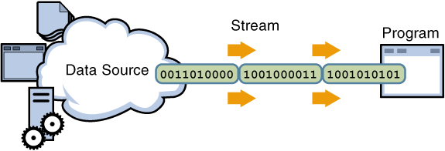
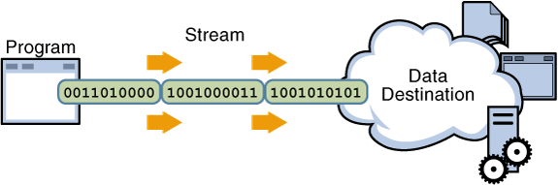
I/O streams

Slide 22
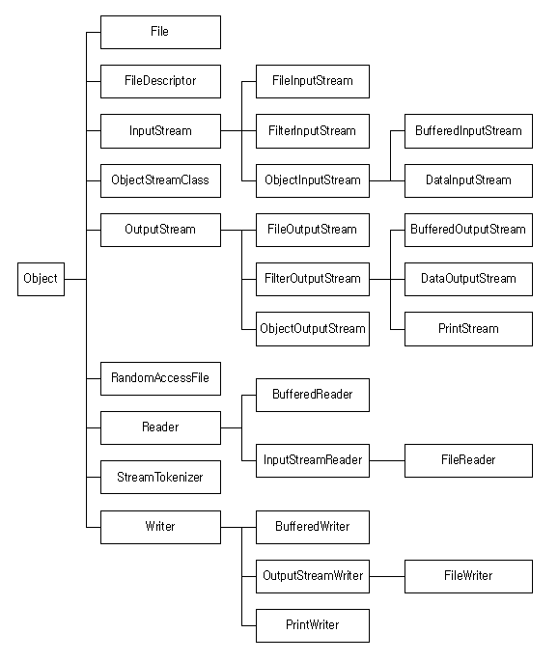
Java.io : hierarchy
InputStream / OutputStream : bytes (8 bit)
Reader / Writer : character (Unicode)
InputStreamReader : bridge bytes -> character
OutputStreamWriter : bridge character-> bytes
BufferedInputStream / BufferedInputStream
BufferedReader / BufferedWriter
File
FileInputStream / FileOutputStream
FileReader / FileWriter

Slide 23
Java.io : InputStream
int read() throws IOException
Reads the next byte of data from the input stream. The value byte is returned as an in the range to . If no byte is available because the end of the stream has been reached, the value is returned. This method blocks until input data is available, the end of the stream is detected, or an exception is thrown.
int read(byte[] b) throws IOException
Reads some number of bytes from the input stream and stores them into the buffer array . The number of bytes actually read is returned as an integer.
int available() throws IOException
Returns an estimate of the number of bytes that can be read (or skipped over) from this input stream without blocking by the next invocation of a method for this input stream.
void close() throws IOException
Closes this input stream and releases any system resources associated with the stream.

Slide 24
Java.io : OutputStream
void write(int b) throws IOException
Writes the specified byte to this output stream. The general contract for is that one byte is written to the output stream. The byte to be written is the eight low-order bits of the argument . The 24 high-order bits of are ignored.
void write(byte[] b) throws IOException
Writes bytes from the specified byte array to this output stream. The general contract for is that it should have exactly the same effect as the call.
void flush() throws IOException
Flushes this output stream and forces any buffered output bytes to be written out. The general contract of is that calling it is an indication that, if any bytes previously written have been buffered by the implementation of the output stream, such bytes should immediately be written to their intended destination.If the intended destination of this stream is an abstraction provided by the underlying operating system, for example a file, then flushing the stream guarantees only that bytes previously written to the stream are passed to the operating system for writing; it does not guarantee that they are actually written to a physical device such as a disk drive.
void close() throws IOException
Closes this output stream and releases any system resources associated with this stream. The general contract of is that it closes the output stream. A closed stream cannot perform output operations and cannot be reopened.

Slide 25
Java.io : Reader
int read() throws IOException
Reads a single character. This method will block until a character is available, an I/O error occurs, or the end of the stream is reached. The character read, as an integer in the range 0 to 65535 (), or -1 if the end of the stream has been reached
int read(char[] cbuf) throws IOException
Reads characters into an array. This method will block until some input is available, an I/O error occurs, or the end of the stream is reached.
boolean ready() throws IOException
True if the next read() is guaranteed not to block for input, false otherwise. Note that returning false does not guarantee that the next read will block.
void close() throws IOException
Closes the stream and releases any system resources associated with it. Once the stream has been closed, further read(), ready(), mark(), reset(), or skip() invocations will throw an IOException. Closing a previously closed stream has no effect.

Slide 26
Java.io : Writer
void write(int c) throws IOException
Writes a single character. The character to be written is contained in the 16 low-order bits of the given integer value; the 16 high-order bits are ignored.
void write(char[] cbuf) throws IOException
Writes an array of characters.
void write(String srt) throws IOException
Writes a string.
void close() throws IOException
Closes the stream, flushing it first. Once the stream has been closed, further write() or flush() invocations will cause an IOException to be thrown. Closing a previously closed stream has no effect.

Slide 27
Java.io : reminder
InputStream / OutputStream : bytes (8 bit)
Reader / Writer : character (Unicode 16 bit)
InputStreamReader : bridge bytes -> character
OutputStreamWriter : bridge character-> bytes
BufferedInputStream / BufferedInputStream
BufferedReader / BufferedWriter
File
FileInputStream / FileOutputStream
FileReader / FileWriter

Slide 28
Java.io : java.io.File
The API says that the class File is "An abstract representation of file and directory pathnames." The File class isn't used to actually read or write data; it's used to work at a higher level, making new empty files, searching for files, deleting files, making directories, and working with paths.
Constructor and Description
File( String pathname ) : Creates a new File instance by converting the given pathname string into an abstract pathname.
File( File parent, String child ) : Creates a new File instance from a parent abstract pathname and a child pathname string.
File( String parent, String child ) : Creates a new File instance from a parent pathname string and a child pathname string.
File( URI uri ) : Creates a new File instance by converting the given file: URI into an abstract pathname.

Slide 29
Java.io : File
boolean | createNewFile() : Atomically creates a new, empty file named by this abstract pathname if and only if a file with this name does not yet exist.
static File | createTempFile(String prefix, String suffix) : Creates an empty file in the default temporary-file directory, using the given prefix and suffix to generate its name.
Boolean | delete() : Deletes the file or directory denoted by this abstract pathname.
boolean | exists() : Tests whether the file or directory denoted by this abstract pathname exists.
String | getAbsolutePath() : Returns the absolute pathname string of this abstract pathname.
long | getFreeSpace() : Returns the number of unallocated bytes in the partition named by this abstract path name.
String | getName() : Returns the name of the file or directory denoted by this abstract pathname.
String | getParent() : Returns the pathname string of this abstract pathname's parent, or null if this pathname does not name a parent directory.
long | getTotalSpace() : Returns the size of the partition named by this abstract pathname.
long | getUsableSpace() : Returns the number of bytes available to this virtual machine on the partition named by this abstract pathname.
boolean | isAbsolute() : Tests whether this abstract pathname is absolute.
boolean | isDirectory() : Tests whether the file denoted by this abstract pathname is a directory.
boolean | isFile() : Tests whether the file denoted by this abstract pathname is a normal file.
long | lastModified() : Returns the time that the file denoted by this abstract pathname was last modified.
String[] | list() : Returns an array of strings naming the files and directories in the directory denoted by this abstract pathname.
boolean | mkdir() : Creates the directory named by this abstract pathname.
boolean | mkdirs() : Creates the directory named by this abstract pathname, including any necessary but nonexistent parent directories.
boolean | renameTo(File dest) : Renames the file denoted by this abstract pathname.
Path | toPath() : Returns a java.nio.file.Path object constructed from the this abstract path.

Slide 30
Java.io : File example
public static void main(String[] args) throws IOException { File file = new File("temp.txt"); // file in working directory file.exists(); // false - file doesn't exist yet file.getName(); // result is 'temp.txt' file.getAbsolutePath(); // result could be like 'D:\part 3\demo\test1.txt' boolean isFileCreated = file.createNewFile(); // result is 'true' file.exists(); // true file.isFile(); // true file.isDirectory(); // false boolean isDirCreated = file.mkdir(); // false - there is already 'temp.txt' File dir = new File("temp2.txt"); isDirCreated = dir.mkdir(); // true - yes, it's ok now. }

Slide 31
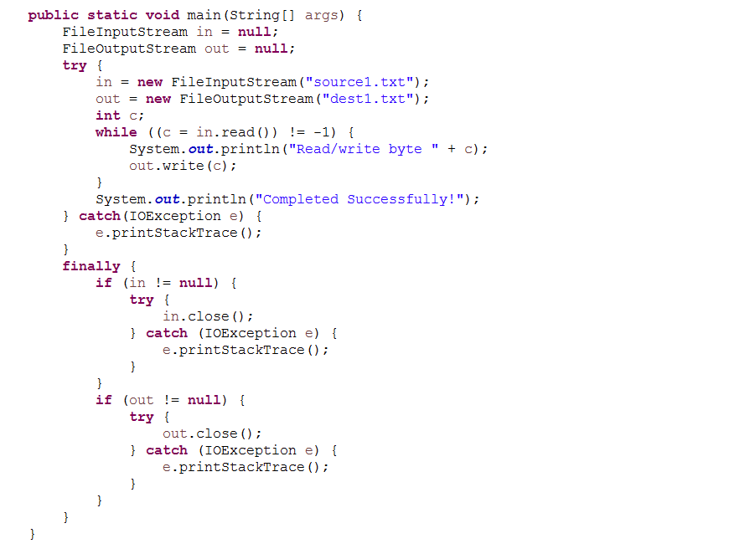
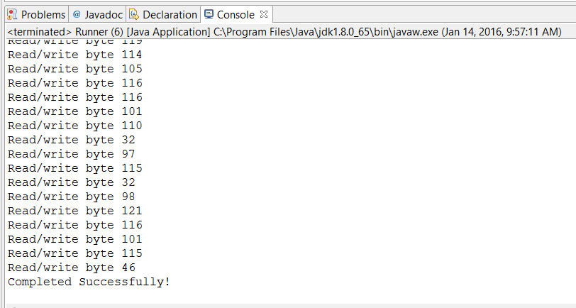
Java.io : read / write a file – bytes

Slide 32
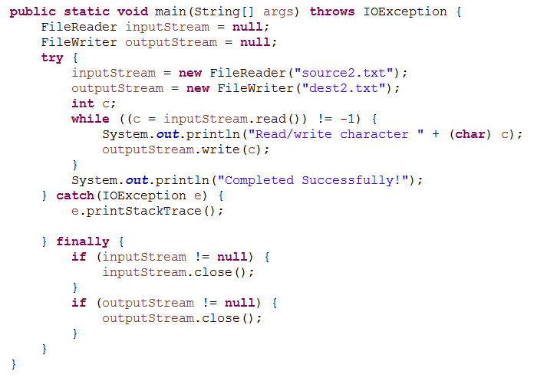
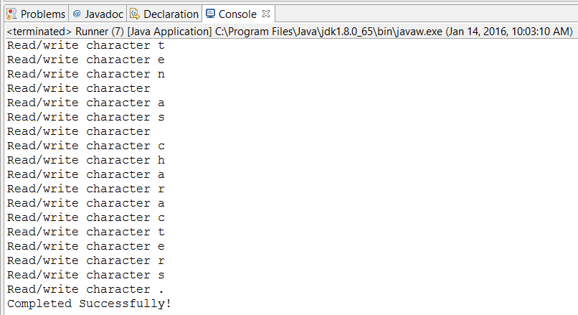
Java.io : read / write a file – characters

Slide 33
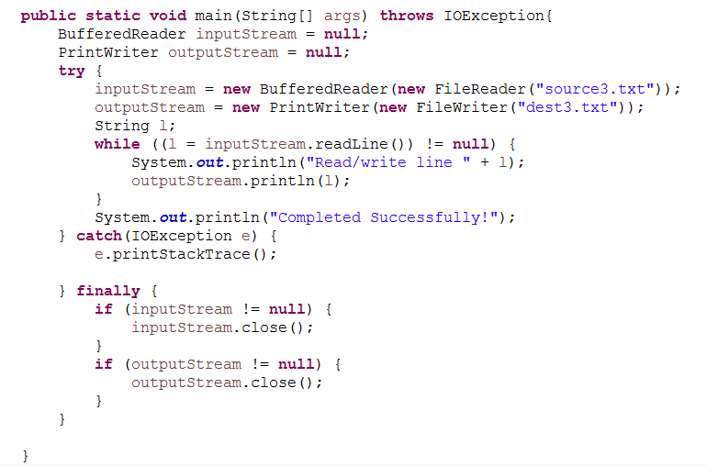
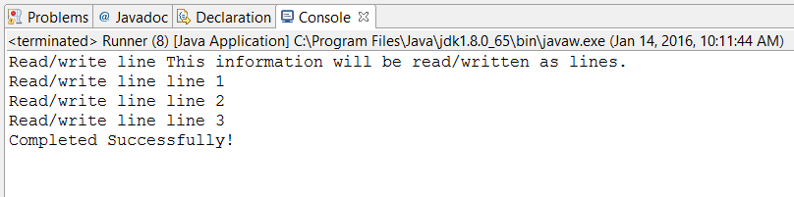
Java.io : read / write a file – lines

Slide 34
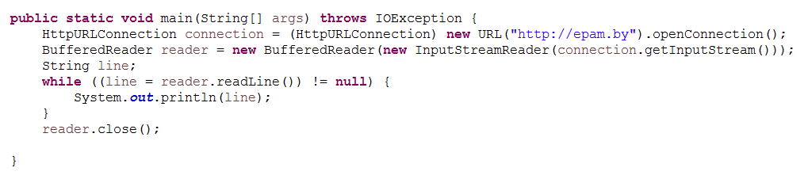
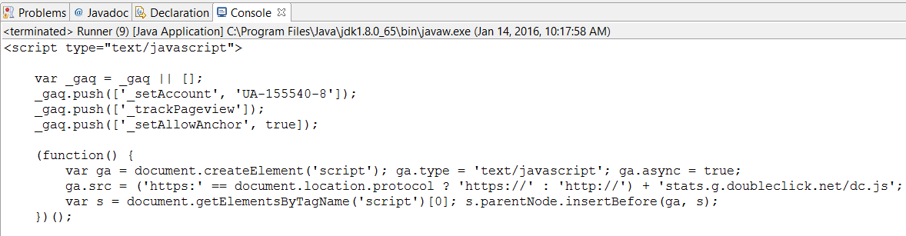
Java.io : bridge ( InputStreamReader/OutputStreamReader )

Slide 35
Home Tasks
Basing on Task 1 of Lecture 2 (a sample will be shared in advance)
Add handling of “user” exceptions
Read data from file / write data to file

Slide 36
Questions ?

Slide 37
Thanks for Your Attention!
EPAM Systems – CN TA 2015-2016 Java Basics Lecture 3
By:
Andrei Kliashchonak Lead Software Test Automation Engineer
EPAM Systems, BY, Test Automation Department #1, Orange Team
E-mail: Andrei_Kliashchonak@epam.com Skype: andrei.kliashchonak

